Slide 1
Classification Metrics

Slide 2
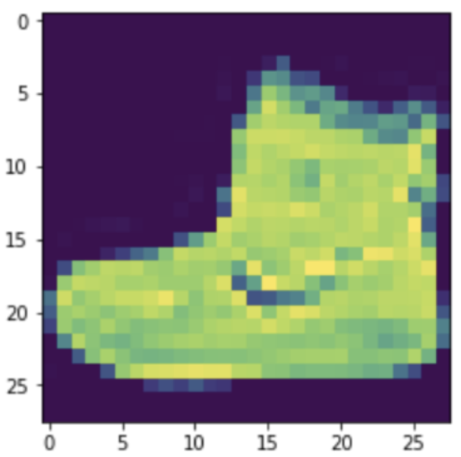
Logistic Regression

Slide 3
Logistic Regression
x₀
x₁
x₂
x₃
x₄
x₅
x₆
x₇
x₈
x₉
…
x₇₈₄

Slide 4
Logistic Regression
x₀
x₁
x₂
x₃
x₄
x₅
x₆
x₇
x₈
x₉
…
x₇₈₄
w₀
w₁
w₂
w₃
w₄
w₅
w₆
w₇
w₈
w₉
…
w₇₈₄

Slide 5
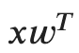
Logistic Regression
x₀
x₁
x₂
x₃
x₄
x₅
x₆
x₇
x₈
x₉
…
x₇₈₄
w₀
w₁
w₂
w₃
w₄
w₅
w₆
w₇
w₈
w₉
…
w₇₈₄
Notes:
unbounded output range

Slide 6
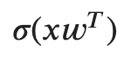
Logistic Regression
x₀
x₁
x₂
x₃
x₄
x₅
x₆
x₇
x₈
x₉
…
x₇₈₄
w₀
w₁
w₂
w₃
w₄
w₅
w₆
w₇
w₈
w₉
…
w₇₈₄
Notes:
sigmoid: 1 / 1+e^-x
probability output

Slide 7
Logistic Regression
x₀
x₁
x₂
x₃
x₄
x₅
x₆
x₇
x₈
x₉
…
x₇₈₄
w₀
w₁
w₂
w₃
w₄
w₅
w₆
w₇
w₈
w₉
…
w₇₈₄
>=0.5
Sneaker
<0.5
Other
Notes:
The selection of the output class depends on a threshold

Slide 8
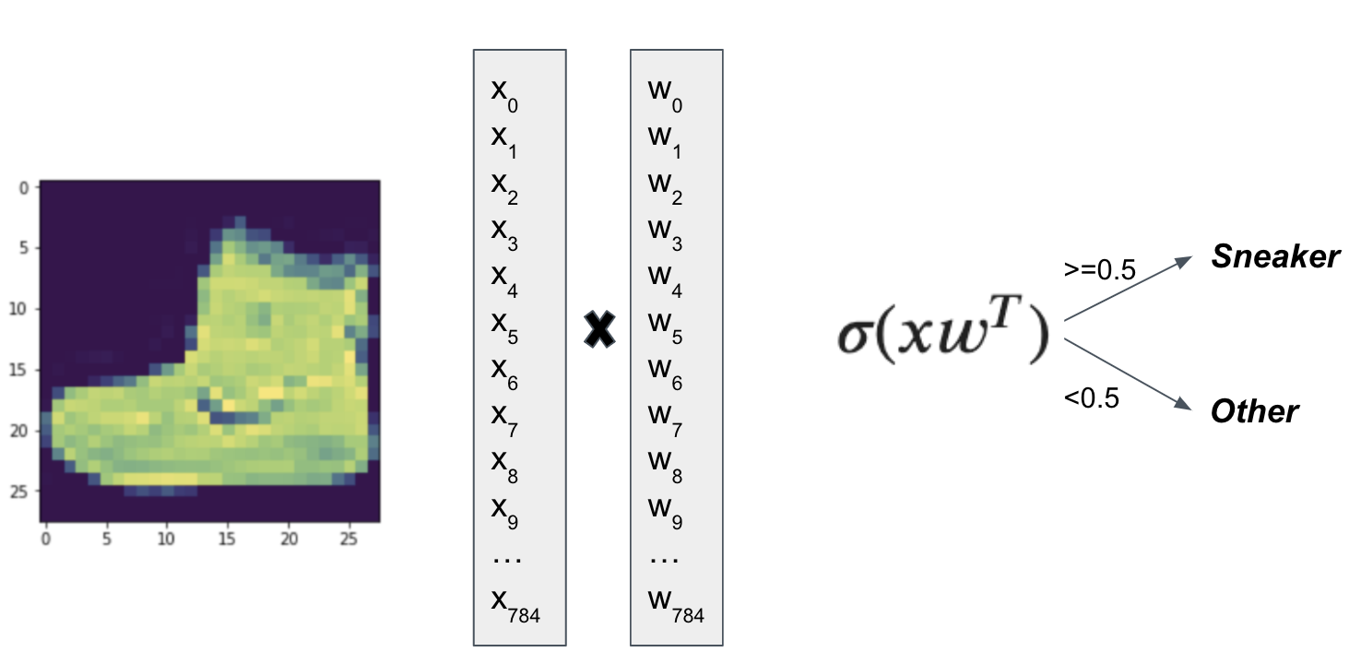
Binary Metrics
 | y’=Sneaker | y’=Other
y=Sneaker
y=Other

Slide 9
Binary Metrics
 | y’=Sneaker | y’=Other
y=Sneaker | True Positive
y=Other

Slide 10
Binary Metrics
 | y’=Sneaker | y’=Other
y=Sneaker | True Positive
y=Other |  | True Negative

Slide 11
Binary Metrics
 | y’=Sneaker | y’=Other
y=Sneaker | True Positive
y=Other | False Positive | True Negative

Slide 12
Binary Metrics
 | y’=Sneaker | y’=Other
y=Sneaker | True Positive | False Negative
y=Other | False Positive | True Negative

Slide 13
Binary Metrics
 | y’=Sneaker | y’=Other
y=Sneaker | TP: 9 | FN: 9
y=Other | FP: 1 | TN: 81
Notes:
Suppose we have 100 test images

Slide 14
Binary Metrics
 | y’=Sneaker | y’=Other
y=Sneaker | TP: 9 | FN: 9
y=Other | FP: 1 | TN: 81
Accuracy
(TP+TN) / (TP+TN+FP+FN)

Slide 15
Binary Metrics
 | y’=Sneaker | y’=Other
y=Sneaker | TP: 9 | FN: 9
y=Other | FP: 1 | TN: 81
Precision
TP / (TP+FP)
Notes:
Precision: of my sneaker predictions, what fraction are correct?
(Column 1)

Slide 16
Binary Metrics
 | y’=Sneaker | y’=Other
y=Sneaker | TP: 9 | FN: 9
y=Other | FP: 1 | TN: 81
Recall
TP / (TP+FN)
Notes:
Recall: of all the sneakers, what fraction did I predict correctly?
(Row 1)

Slide 17
Binary Metrics
Sneaker
Other
Logistic Regression Output
0.0
1.0
Notes:
The color of these dots represents the actual label.
Whether it is classified correctly or not depends on where our threshold is.

Slide 18
Binary Metrics
 | y’=Sneaker | y’=Other
y=Sneaker
y=Other
Classification Threshold
Sneaker
Other
Logistic Regression Output
0.0
1.0
Notes:
Red left of threshold: TN (8)
Green right of threshold: TP (9)
Red right of threshold: FP (3)
Green left of threshold: FN (0)
Precision = TP / (TP+FP) = 9 / 12
Recall = TP / (TP+FN) = 9 / 9

Slide 19
Binary Metrics
 | y’=Sneaker | y’=Other
y=Sneaker | TP: 9 | FN: 0
y=Other | FP: 3 | TN: 8
Classification Threshold
Sneaker
Other
Logistic Regression Output
0.0
1.0
Notes:
Red left of threshold: TN (8)
Green right of threshold: TP (9)
Red right of threshold: FP (3)
Green left of threshold: FN (0)
Precision = TP / (TP+FP) = 9 / 12
Recall = TP / (TP+FN) = 9 / 9

Slide 20
Binary Metrics
 | y’=Sneaker | y’=Other
y=Sneaker
y=Other
Classification Threshold
Sneaker
Other
Logistic Regression Output
0.0
1.0
Notes:
Red left of threshold: TN (11)
Green right of threshold: TP (6)
Red right of threshold: FP (0)
Green left of threshold: FN (3)
Precision = TP / (TP+FP) = 6 / 6
Recall = TP / (TP+FN) = 6 / 9

Slide 21
Binary Metrics
 | y’=Sneaker | y’=Other
y=Sneaker | TP: 6 | FN: 3
y=Other | FP: 0 | TN: 11
Classification Threshold
Sneaker
Other
Logistic Regression Output
0.0
1.0
Notes:
Red left of threshold: TN (11)
Green right of threshold: TP (6)
Red right of threshold: FP (0)
Green left of threshold: FN (3)
Precision = TP / (TP+FP) = 6 / 6
Recall = TP / (TP+FN) = 6 / 9

Slide 22
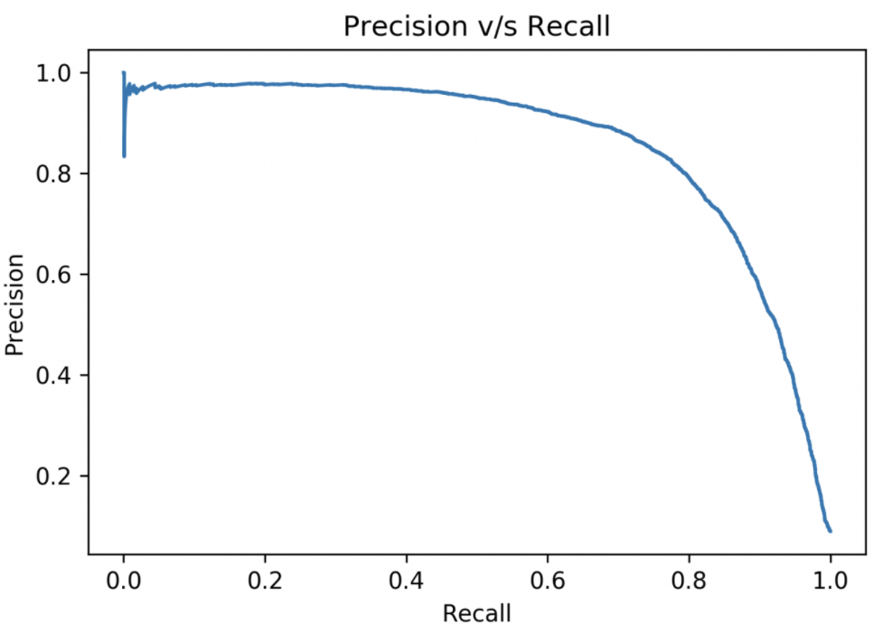
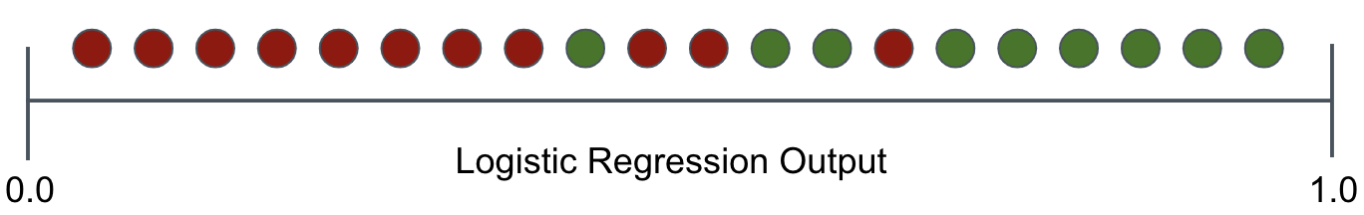
Precision/Recall Curve
Notes:
Compute P,R for many thresholds
Perfect classifier?
Baseline: horizontal at 0.5 for balanced data
AUC/AP

Slide 23
Classification Metrics
Notes:
Q: [True/False] As you adjust the classification threshold, when precision increases, recall increases too.
A: False

Slide 24
Multiclass Classification

Slide 25
Multiclass Classification
Fashion MNIST classes
0 T-shirt/top
1 Trouser
2 Pullover
3 Dress
4 Coat
5 Sandal
6 Shirt
7 Sneaker
8 Bag
9 Ankle boot

Slide 26
Multiclass Classification
k binary classifiers
Each classifier has its own parameters
Fashion MNIST classes
0 T-shirt/top
1 Trouser
2 Pullover
3 Dress
4 Coat
5 Sandal
6 Shirt
7 Sneaker
8 Bag
9 Ankle boot

Slide 27
Multiclass Classification
k binary classifiers
Each classifier has its own parameters
Fashion MNIST classes
0 T-shirt/top
1 Trouser
2 Pullover
3 Dress
4 Coat
5 Sandal
6 Shirt
7 Sneaker
8 Bag
9 Ankle boot
Classifier 0
Classifier 1
...
Classifier 9

Slide 28
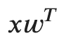
Multiclass Classification
k binary classifiers
Each classifier has its own parameters
Fashion MNIST classes
0 T-shirt/top
1 Trouser
2 Pullover
3 Dress
4 Coat
5 Sandal
6 Shirt
7 Sneaker
8 Bag
9 Ankle boot
Classifier 0
Classifier 1
...
Classifier 9
Notes:
w_j is the set of 784 parameters for class j

Slide 29
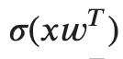
Multiclass Classification
k binary classifiers
Each classifier has its own parameters
Fashion MNIST classes
0 T-shirt/top
1 Trouser
2 Pullover
3 Dress
4 Coat
5 Sandal
6 Shirt
7 Sneaker
8 Bag
9 Ankle boot
Classifier 0
0.12
Classifier 1
0.06
...
Classifier 9
0.78

Slide 30
Multiclass Classification
k binary classifiers
Each classifier has its own parameters
Fashion MNIST classes
0 T-shirt/top
1 Trouser
2 Pullover
3 Dress
4 Coat
5 Sandal
6 Shirt
7 Sneaker
8 Bag
9 Ankle boot
Classifier 0
0.12
Classifier 1
0.06
...
Classifier 9
0.78
Sum != 1

Slide 31
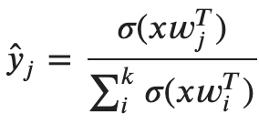
Multiclass Classification
Softmax normalization scales a set of scores to a multinomial probability distribution

Slide 32
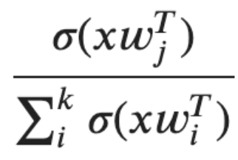
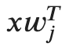
Multiclass Classification
k binary classifiers
Each classifier has its own parameters
Fashion MNIST classes
0 T-shirt/top
1 Trouser
2 Pullover
3 Dress
4 Coat
5 Sandal
6 Shirt
7 Sneaker
8 Bag
9 Ankle boot
Classifier 0
0.04
Classifier 1
0.02
...
Classifier 9
0.75
Sum == 1

Slide 33
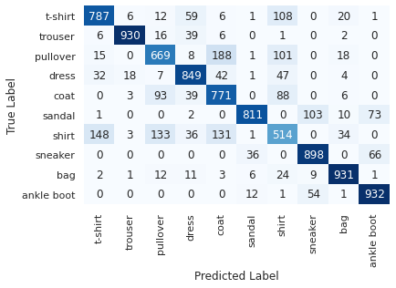
Multiclass Confusion Matrix

Slide 34
Multiclass Classification
Notes:
Q: [True/False] In a multiclass logistic regression model, each class has its own set of parameters.
A: True

Slide 35
Multiclass Loss

Slide 36
Multiclass Labels
Binary Labels
y = 0 (negative class)
y = 1 (positive class)
Sneaker Classifier
0.82

Slide 37
Multiclass Labels
Label Vector
y = [1,0,0,0,0,0,0,0,0,0] (class 0)
y = [0,1,0,0,0,0,0,0,0,0] (class 1)
y = [0,0,1,0,0,0,0,0,0,0] (class 2)
...
Classifier 0
0.04
Classifier 1
0.02
...
Classifier 9
0.75
Notes:
Remember the difference between dense (or one-hot) and sparse representations

Slide 38
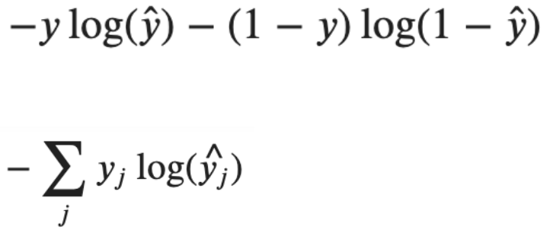
Cross Entropy Loss
Binary log loss
Multiclass log loss
(cross-entropy loss)
Label Vector
y = [1,0,0,0,0,0,0,0,0,0] (class 0)
y = [0,1,0,0,0,0,0,0,0,0] (class 1)
y = [0,0,1,0,0,0,0,0,0,0] (class 2)
...
Notes:
only 1 term is non-zero

Slide 39
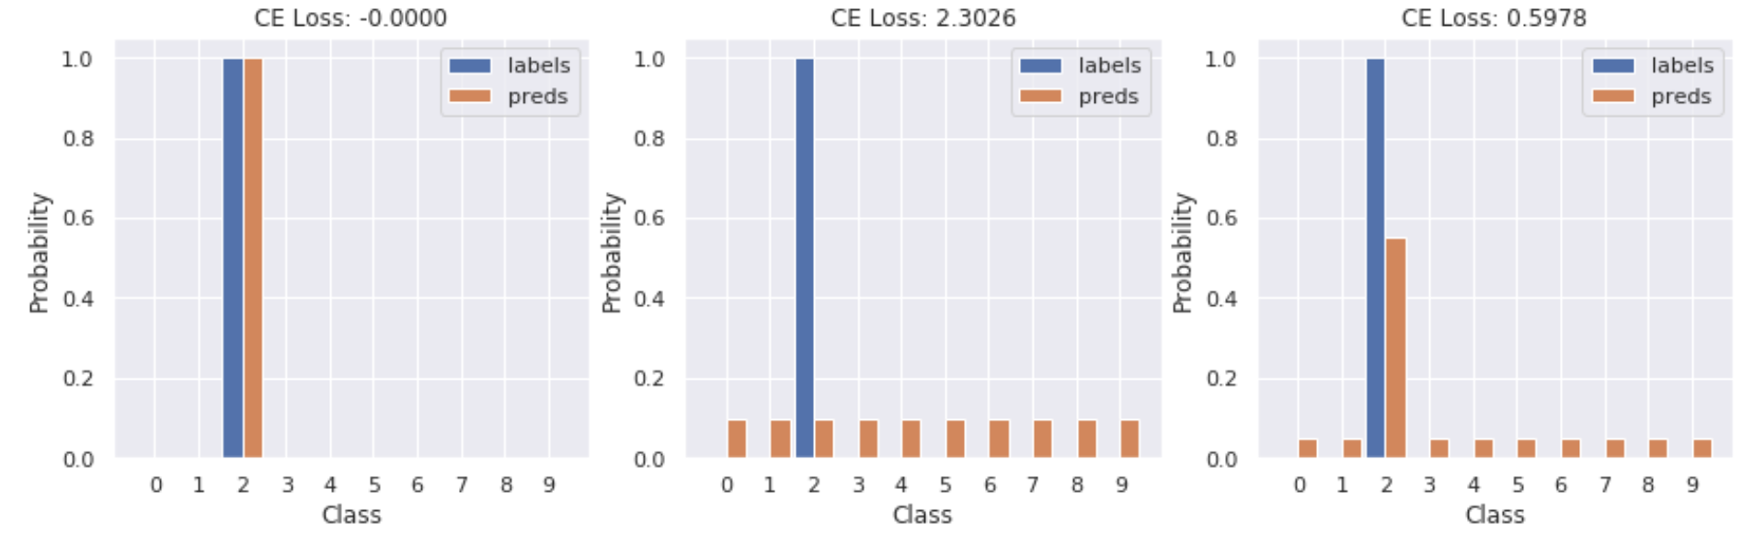
Cross Entropy Loss
Cross entropy compares the predicted distribution to the true distribution

Slide 40
Multiclass Loss
Notes:
Q: [True/False] Cross-entropy loss is only valid when the label distribution is one-hot.
A: False

Slide 41
Network Graphs

Slide 42
Multiclass Logistic Regression
Input Layer
Output Layer
x₀
y₀
x₁
y₁
x₂
y₂
x₃

Slide 43
Multiclass Logistic Regression
Input Layer
Output Layer
x₀
y₀
x₁
y₁
x₂
y₂
x₃

Slide 44
Multiclass Logistic Regression
Input Layer
Output Layer
x₀
w_{0,0}
y₀
x₁
y₁
x₂
y₂
x₃
w_{3,2}
Notes:
weights are indexed by their from-node followed by their to-node

Slide 45
Multiclass Logistic Regression
Input Layer
Output Layer
x₀
w_{0,0}
∑ σ
y₀
x₁
y₁
x₂
y₂
x₃
w_{3,2}
Notes:
x0*w00 + x1*w10 + x2*w20 + x3*w30
sigmoid: 1/1+e^-x

Slide 46
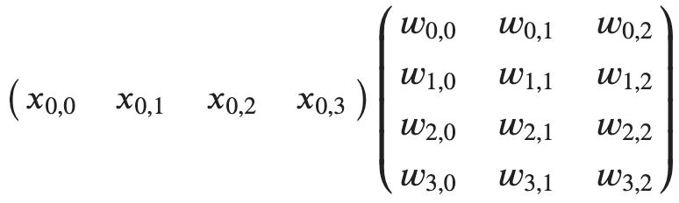
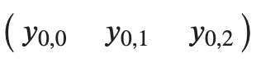
Multiclass Logistic Regression
Input Layer
Output Layer
x₀
w_{0,0}
y₀
x₁
σ
y₁
x₂
y₂
x₃
w_{3,2}

Slide 47
Multiclass Logistic Regression
Input Layer
Output Layer
x₀
w_{0,0}
y₀
x₁
σ
y₁
x₂
y₂
x₃
w_{3,2}

Slide 48
Multiclass Logistic Regression
Input Layer
Output Layer
x₀
w_{0,0}
y₀
x₁
σ
y₁
x₂
y₂
x₃
w_{3,2}

Slide 49
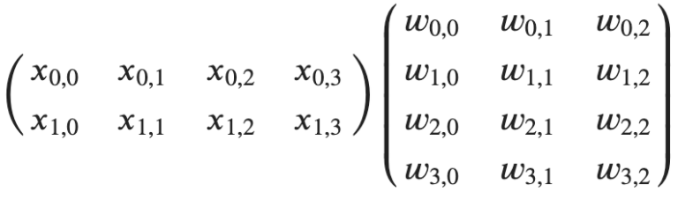
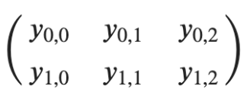
Multiclass Logistic Regression
Input Layer
Output Layer
x₀
w_{0,0}
y₀
x₁
σ
y₁
x₂
y₂
x₃
w_{3,2}

Slide 50
Neural Networks Preview
Input Layer
Hidden Layer
Output Layer
x₀
h₀
y₀
x₁
h₁
y₁
x₂
h₂
y₂
x₃

Slide 51
Network Graphs
Notes:
Q: [True/False] Logistic regression output can be computed with a single matrix multiplication (and a sigmoid).
A: True

Slide 52
Linear Model Limitations

Slide 53
What Does the Model Know?
weights, bias = model.layers[1].get_weights()
for i in range(10):
plt.imshow(weights[:,i].reshape(28,28))

Slide 54
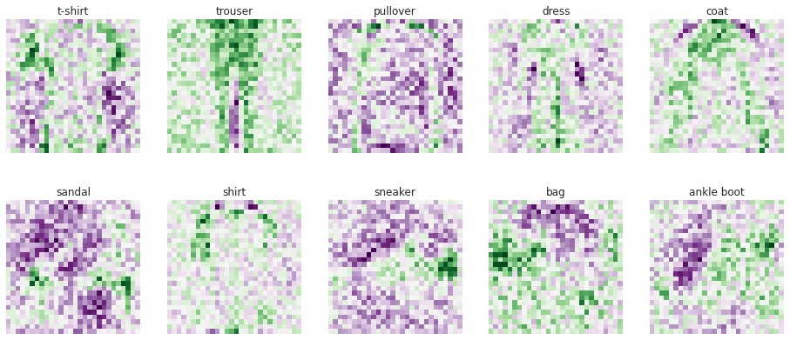
What Does the Model Know?
weights, bias = model.layers[1].get_weights()
for i in range(10):
plt.imshow(weights[:,i].reshape(28,28))

Slide 55
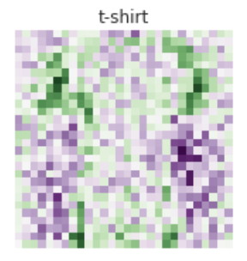
Linear Models for Images
Sensitive to size, color, orientation
No concept of edges
No concept of structure -- relation between pixels

Slide 56

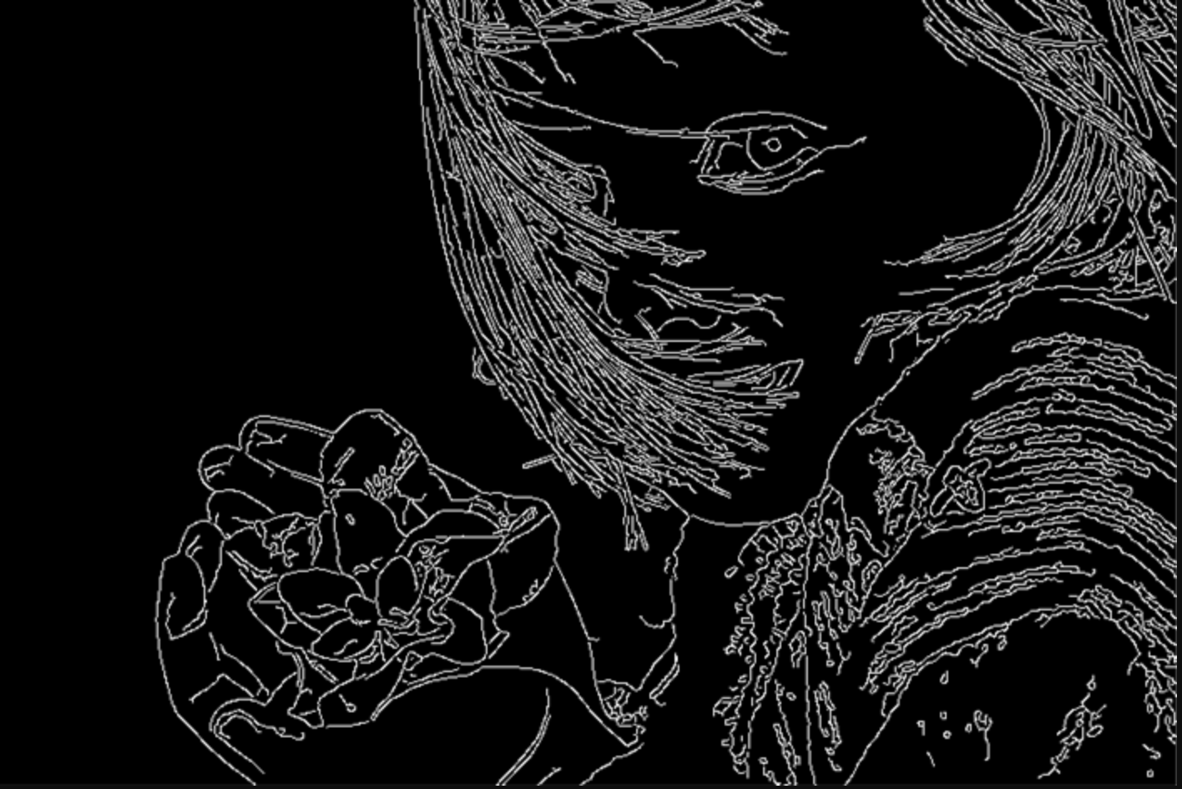
Edge Detection
Find sharp changes in pixel intensity
This is a (spatial) gradient
The gradient computation can be approximated by a special computation -- a convolution.
[source]

Slide 57
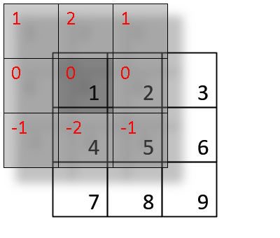
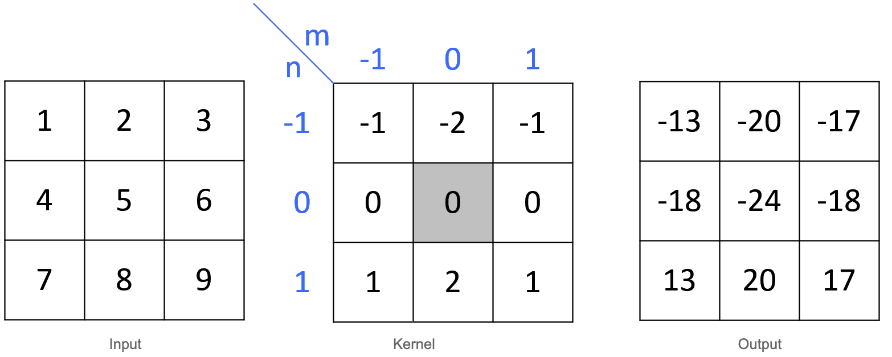
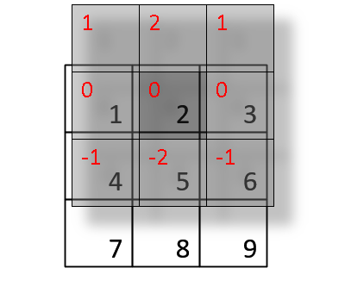
Convolution, Briefly
Input
Kernel
Output
[source]

Slide 58
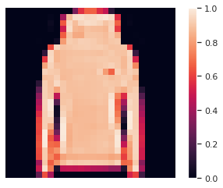
Convolution for Edge Detection
Original

Slide 59
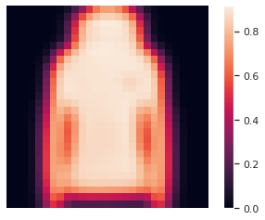
Convolution for Edge Detection
Original
Smoothed

Slide 60
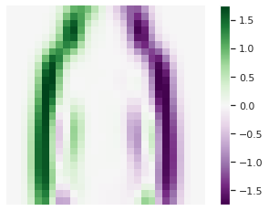
Convolution for Edge Detection
Original
Smoothed
Edges

Slide 61
Convolution for Edge Detection
Original
Smoothed
Edges
filter = np.array([[1, 0, -1],
[1, 0, -1],
[1, 0, -1]])
orig = X_train[4]
smoothed = scipy.ndimage.gaussian_filter(orig, sigma=1)
filtered = scipy.signal.convolve2d(
smoothed, filter, boundary='symm', mode='same')

Slide 62
Linear Models for Text
x₀
x₁
x₂
x₃
x₄
x₅
x₆
x₇
x₈
x₉
…
x_{k}
w₀
w₁
w₂
w₃
w₄
w₅
w₆
w₇
w₈
w₉
…
w_{k}
not
my
favorite
film
>=0.5
Positive
<0.5
Negative

Slide 63
Linear Model Limitations
Notes:
Q: [True/False] A linear model must rely on hand-crafted input features if it is to understand complex structure.
A: True

Slide 64
Digit Classification History

Slide 65
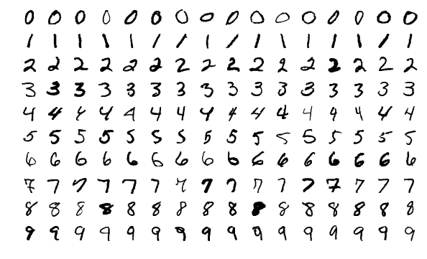
MNIST Dataset
“Modified National Institutes of Standards and Technology”
Released in 1999
70k handwritten digits
40k from 250 Census Bureau workers
30k from 500 High School students

Slide 66
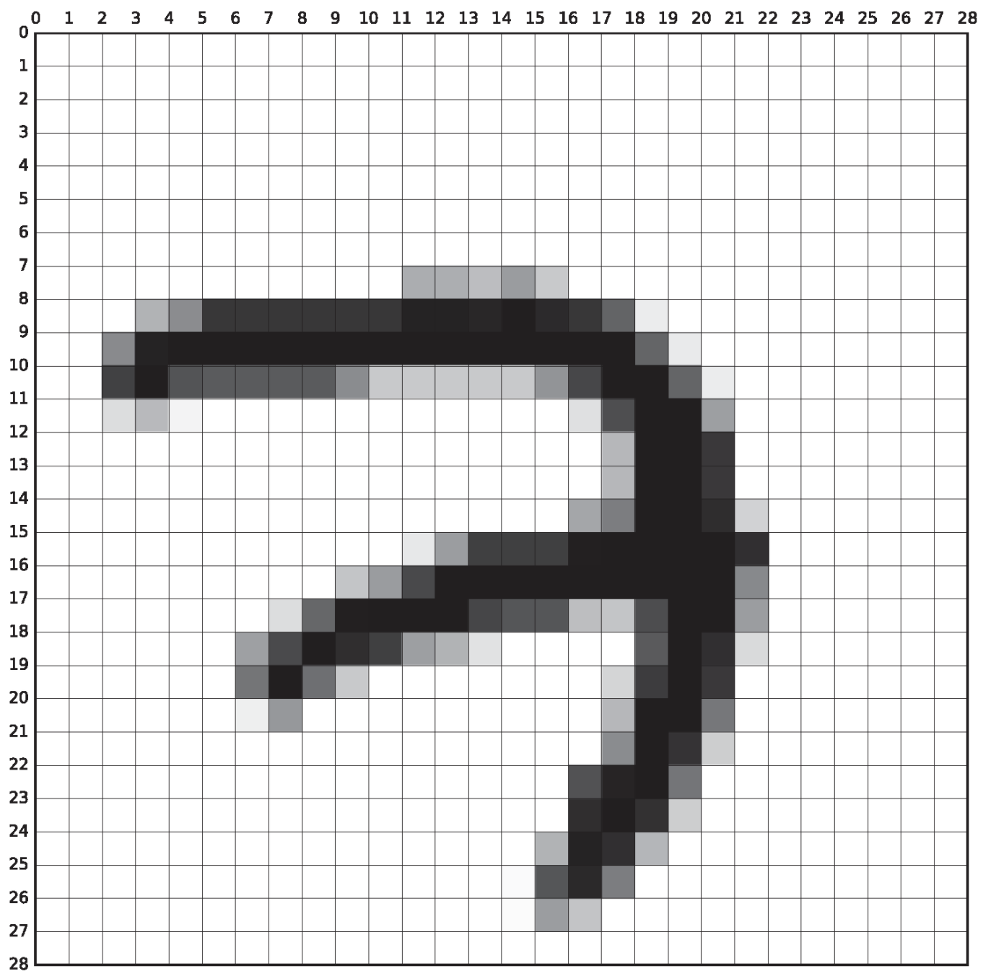
MNIST Dataset
Image pre-processing
Scaled to 20x20 pixels
Centered in 28x28 pixels (center of mass)
Smoothed (anti-aliasing) producing grayscale values

Slide 67
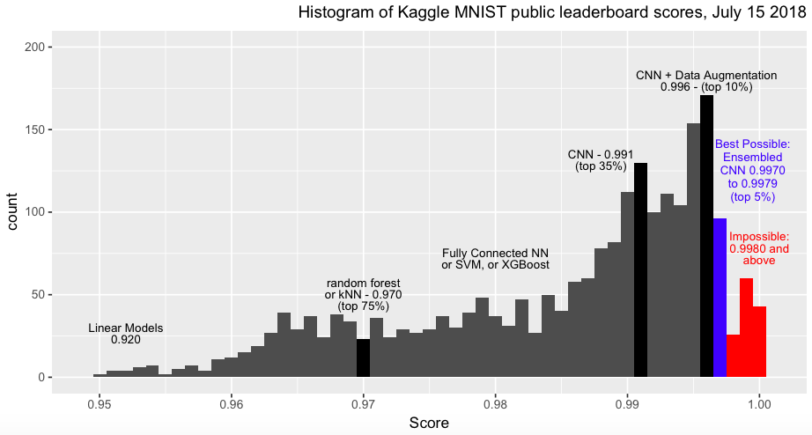
MNIST Results
[source]

Slide 68
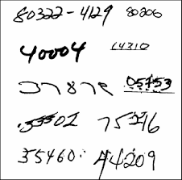
Mail Sorting
Recognizing zip codes has extra challenges
Locating the zip code span
Size and spacing variability
Separation between digits
[source]

Slide 69
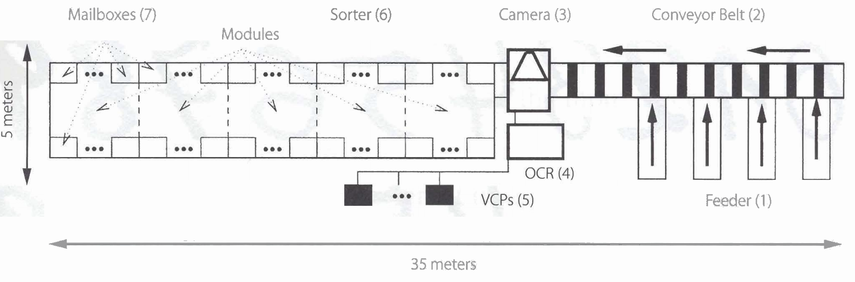
Mail Sorting in 1999
[source]
Figure 1 shows a diagram of a GSA postal sorting machine. The envelopes are fed into the GSA and are separated by four feeders (1). They are transported on a conveyor belt (2) running at about 2m/s.They go below the linescanning camera (3), which captures a greyscale image of each letter. While the letter is passed to the sorter (6), the GSA-OCR (4) Starts processing the image to recognize the destination address. lf no valid address is found,the image is delivered to video coding places VCPs (5), where postal workers handle it. If the ZIP code information can be automatically recognized or is entered by a human Operator, the letter is dropped in one of 200 mailboxes (7), each one covering different ZIP code ranges.

Slide 70
Digit Classification History
Notes:
Q: [True/False] A model trained for the MNIST digit classification task could be applied directly to mail sorting by zip-code.
A: False

